Slide 1
Blacktown Chinese Christian Church
Welcome to Our English Service 13.07.2025
English Service 9:45 – 11:00 am
Worship Songs: Passage: Speaker: Topic: Response Song: Announcements and Closing Prayer Benediction
I will trust my saviour jesus King of kings O come to the altar Jeremiah 1: 4-10, 17-19 Xavier Lakshmanan Jeremiah: God's Exalted Prophet TBA

Slide 2
BCCC english service

Slide 3

Please keep all phones on silent

Slide 4
I Will Trust My Saviour Jesus
CCLI Licence No: 5485849

Slide 5
I will trust my Saviour Jesus
When my darkest doubts befall
Trust Him when to simply trust Him
Seems the hardest thing of all

Slide 6
I will trust my Saviour Jesus
Trust Him when my strength is small
For I know the shield of Jesus
Is the safest place of all

Slide 7
Jesus, only Jesus
Help me trust You more and more
Jesus, only Jesus
May my heart be ever Yours

Slide 8
I will trust my Saviour Jesus
He has said His way is best
And I know the path He's chosen
Leads to everlasting rest

Slide 9
Jesus, only Jesus
Help me trust You more and more
Jesus, only Jesus
May my heart be ever Yours (x2)

Slide 10
Oh on that cross, how it was seen
I can go now ever trusting in the One who died for me

Slide 11
What could I bring for Your gift is complete
So I trust You, simply trust You, Lord,
With every part of me

Slide 12
Oh on that cross, how it was seen
I can go now ever trusting in the One who died for me

Slide 13
What could I bring for Your gift is complete
So I trust You, simply trust You, Lord,
With every part of me

Slide 14
Oh on that cross, how it was seen
I can go now ever trusting in the One who died for me

Slide 15
What could I bring for Your gift is complete
So I trust You, simply trust You, Lord,
With every part of me

Slide 16
Jesus, only Jesus
Help me trust You more and more
Jesus, only Jesus
May my heart be ever Yours (x2)

Slide 17
King Of Kings
CCLI Licence No: 5485849

Slide 18
In the darkness we were waiting
Without hope, without light
Till from heaven You came running
There was mercy in Your eyes

Slide 19
To fulfill the law and prophets
To a virgin came the word
From a throne of endless glory
To a cradle in the dirt

Slide 20
Praise the Father, praise the Son
Praise the Spirit, three in one
God of glory, Majesty
Praise forever to the King of Kings

Slide 21
To reveal the kingdom coming
And to reconcile the lost
To redeem the whole creation
You did not despise the cross

Slide 22
For even in your suffering
You saw to the other side
Knowing this was our salvation
Jesus for our sake you died

Slide 23
Praise the Father, praise the Son
Praise the Spirit, three in one
God of glory, Majesty
Praise forever to the King of Kings

Slide 24
And the morning that You rose
All of heaven held its breath
Till that stone was moved for good
For the Lamb had conquered death

Slide 25
And the dead rose from their tombs
And the angels stood in awe
For the souls of all who'd come
To the Father are restored

Slide 26
And the Church of Christ was born
Then the Spirit lit the flame
Now this gospel truth of old
Shall not kneel, shall not faint

Slide 27
By His blood and in His name
In His freedom I am free
For the love of Jesus Christ
Who has resurrected me

Slide 28
Praise the Father, praise the Son
Praise the Spirit, three in one
God of glory, Majesty
Praise forever to the King of Kings

Slide 29
Praise forever to the King of Kings

Slide 30
O Come To The Altar
CCLI Licence No: 5485849

Slide 31
Are you hurting and broken within?
Overwhelmed by the weight of your sin?
Jesus is calling

Slide 32
Have you come to the end of yourself
Do you thirst for a drink from the well?
Jesus is calling

Slide 33
O come to the altar
The Father's arms are open wide
Forgiveness was bought with
The precious blood of Jesus Christ

Slide 34
Leave behind your regrets and mistakes
Come today, there's no reason to wait
Jesus is calling

Slide 35
Bring your sorrows and trade them for joy
From the ashes, a new life is born
Jesus is calling

Slide 36
O come to the altar
The Father's arms are open wide
Forgiveness was bought with
The precious blood of Jesus Christ

Slide 37
O come to the altar
The Father's arms are open wide
Forgiveness was bought with
The precious blood of Jesus Christ

Slide 38
Oh what a Savior
Isn't He wonderful?
Sing Hallelujah, Christ is risen

Slide 39
Bow down before Him
For He is Lord of all
Sing Hallelujah, Christ is risen

Slide 40
Oh what a Savior
Isn't He wonderful?
Sing Hallelujah, Christ is risen

Slide 41
Bow down before Him
For He is Lord of all
Sing Hallelujah, Christ is risen

Slide 42
O come to the altar
The Father's arms are open wide
Forgiveness was bought with
The precious blood of Jesus Christ

Slide 43
O come to the altar
The Father's arms are open wide
Forgiveness was bought with
The precious blood of Jesus Christ

Slide 44
Bear your cross as you wait for the crown
Tell the world of the treasure you found

Slide 45
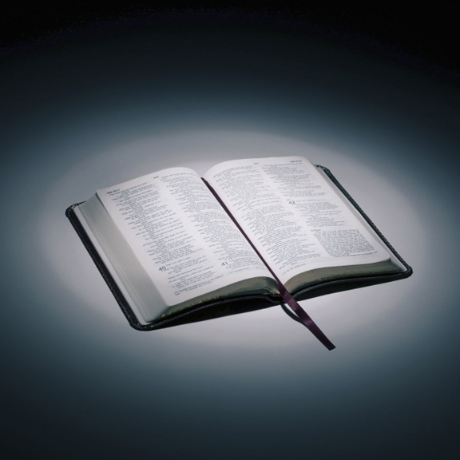
Bible reading

Slide 46
Jeremiah 1: 4-10, 17-19
⁴ The word of the Lord came to me, saying,
⁵ “Before I formed you in the womb I knew you,
before you were born I set you apart;
I appointed you as a prophet to the nations.”

Slide 47
Jeremiah 1: 4-10, 17-19
⁶ “Alas, Sovereign Lord,” I said, “I do not know how to speak; I am too young.”
⁷ But the Lord said to me, “Do not say, ‘I am too young.’ You must go to everyone I send you to and say whatever I command you.

Slide 48
Jeremiah 1: 4-10, 17-19
⁸ Do not be afraid of them, for I am with you and will rescue you,” declares the Lord.
⁹ Then the Lord reached out his hand and touched my mouth and said to me, “I have put my words in your mouth.

Slide 49
Jeremiah 1: 4-10, 17-19
¹⁰ See, today I appoint you over nations and kingdoms to uproot and tear down, to destroy and overthrow, to build and to plant.”
¹⁷ “Get yourself ready! Stand up and say to them whatever I command you. Do not be terrified by them, or I will terrify you before them.

Slide 50
Jeremiah 1: 4-10, 17-19
¹⁸ Today I have made you a fortified city, an iron pillar and a bronze wall to stand against the whole land—against the kings of Judah, its officials, its priests and the people of the land. ¹⁹ They will fight against you but will not overcome you, for I am with you and will rescue you,” declares the Lord.

Slide 51
Announcements

Slide 52





Account name: Blacktown Chinese Christian Church
Account number: 4216 50263
Offering
BSB: 112 - 879
Please put in "offering" as the reference
The offering box is available at the back of the hall

Slide 53
Prayer points

Slide 54
Mingle time!

